Slide 1
Class Feud
Semester 1 Test Review 2016

Slide 2
Round 1
Your team will earn 1 point for each correct answer.

Slide 3
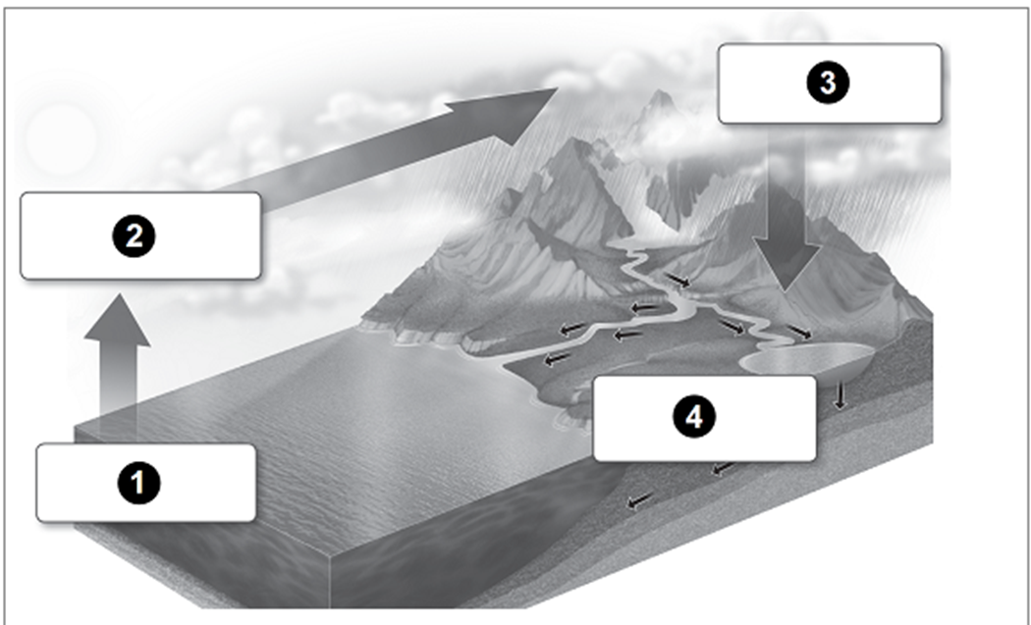
Which process usually takes place right after water droplets fall back to Earth?
A condensation
B evaporation
C precipitation
D runoff

Slide 4
What is a continent?
A a group of islands
B a large landmass
C a chain of mountains
D a large body of water

Slide 5
What does the Mercator map projection show accurately, making it useful for navigators?
A area
B continent shape
C direction
D ocean shape

Slide 6
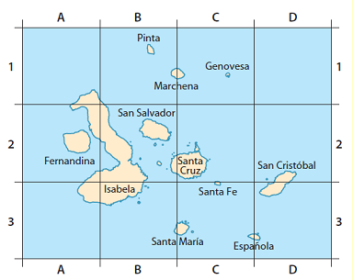
What are the grid coordinates of Fernandina?
A A1
B A2
C A3
D B2

Slide 7
Which type of map shows the distribution of various resources?
A climate map
B topographical map
C resource map
D economic map

Slide 8
What two events often take place along the Ring of Fire?
A floods and cyclones
B droughts and hurricanes
C tornadoes and typhoons
D volcanoes and earthquakes

Slide 9
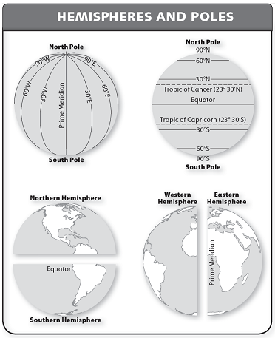
What imaginary line sits approximately 23˚ north of the equator?
A prime longitude
B prime meridian
C Tropic of Cancer
D Tropic of Capricorn

Slide 10
What divides the Western Hemisphere from the Eastern Hemisphere?
A the equator
B the prime meridian
C the Tropic of Cancer
D the Tropic of Capricorn

Slide 11
What is the purpose of a map legend?
A list the names of places on a map
B explain the meaning of symbols and colors on a map
C show the unit of distance used on a map
D point out the specific area of the world shown on a map

Slide 12
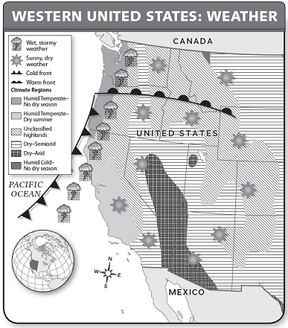
Because of the cold front shown on the map, what type of weather is hitting a major part of the coast?
A dry and sunny
B hot and humid
C warm and windy
D wet and stormy

Slide 13
What sits at 0˚ longitude?
A Equator
B Prime Meridian
C Tropic of Capricorn
D Tropic of Cancer

Slide 14
Why do continents move?
A They collide with Earth’s crust, which shifts their position.
B They shift because of volcanoes, which form under the ocean.
C They rest on tectonic plates, which change position over time.
D They spread apart during earthquakes, which happen often.

Slide 15
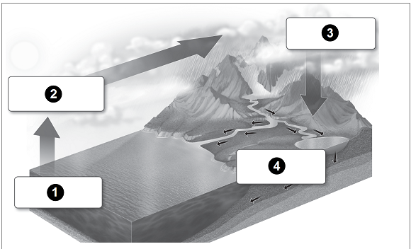
What is the role of the sun during evaporation?
A It heats the ocean, making water vapor rise.
B It makes water droplets heavy, creating rain.
C It heats the atmosphere and causes clouds.
D It makes water run into rivers and ocean.

Slide 16
What is a Mercator map used for?
A Used for distance
B Used for accurate area
C Used for seeing the poles
D Used for navigation

Slide 17
What is literacy rate?
A How many people are born
B How many people die
C How long you live
D How many people can read and write

Slide 18
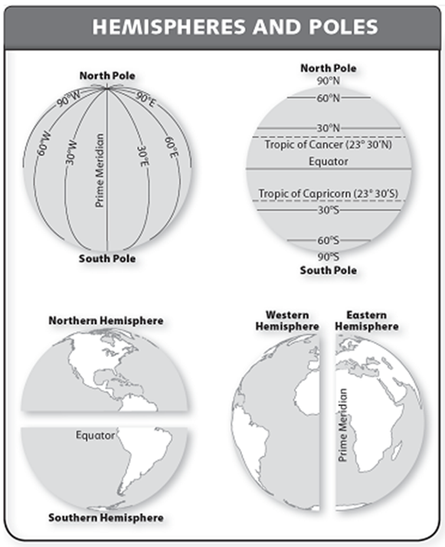
What is one way that latitude lines and longitude lines are different?
A Latitude lines are measured in degrees; longitude lines are not.
B Latitude lines are horizontal, north-south; longitude lines are vertical, east-west.
C Latitude lines never touch each other; longitude lines meet.
D Latitude lines start at the North Pole; longitude lines start at the South Pole.

Slide 19
Round 2
Your team will earn 2 points for each correct answer.
Your team will lose 1 point for each wrong answer.

Slide 20
Resources that do not run out but do not need to be renewed or regrown are called _____.
A renewable
B nonrenewable
C flow
D mineral

Slide 21
When the sun heats the ocean and water vapor rises into the air, what is it called?
A condensation
B evaporation
C precipitation
D runoff

Slide 22

Based on the symbols shown, what two kinds of weather are occurring north of the warm front?
A dry and cold
B stormy and sunny
C sunny and humid
D warm and windy

Slide 23
How long does it take Earth to make one revolution around the sun?
A one day
B one week
C one month
D one year

Slide 24
Oil is what kind of resource?
A renewable
B flow
C mineral
D nonrenewable

Slide 25
When water soaks into the ground and flows into rivers, lakes, and underground reservoirs, what is the process called?
A condensation
B evaporation
C precipitation
D runoff

Slide 26
A large scale map shows _____.
A more detail
B less detail
C physical features
D political features

Slide 27
What sits at 0˚ latitude?
A South Pole
B North Pole
C prime meridian
D the equator

Slide 28
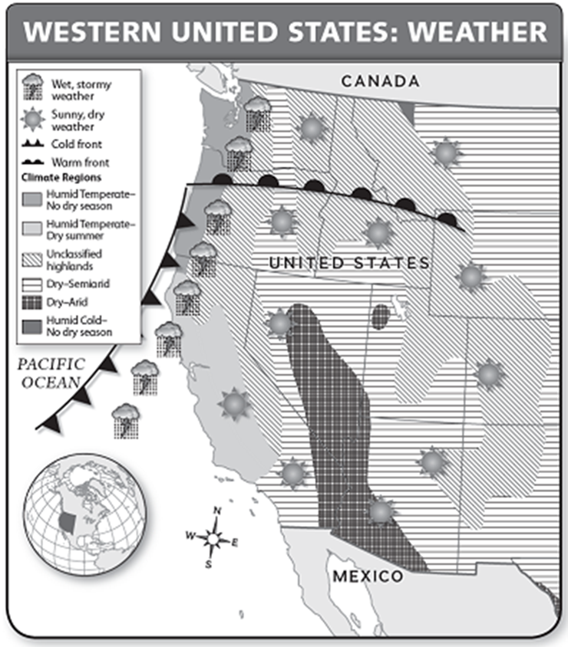
What is the weather like for most of the western United States?
A cold and stormy
B dry and sunny
C humid and sunny
D wet and stormy

Slide 29
What theme of geography explains how people, ideas, and animals get from one place to another?
A location
B movement
C place
D region

Slide 30
What imaginary line connects the North Pole and the South Pole?
A prime meridian
B the equator
C Tropic of Cancer
D Tropic of Capricorn

Slide 31
Why are seasons opposite in the northern and southern hemispheres?
A The earth is tilted at an angle
B The sun is tilted at an angle
C The earth is spinning
D The earth goes around the sun

Slide 32
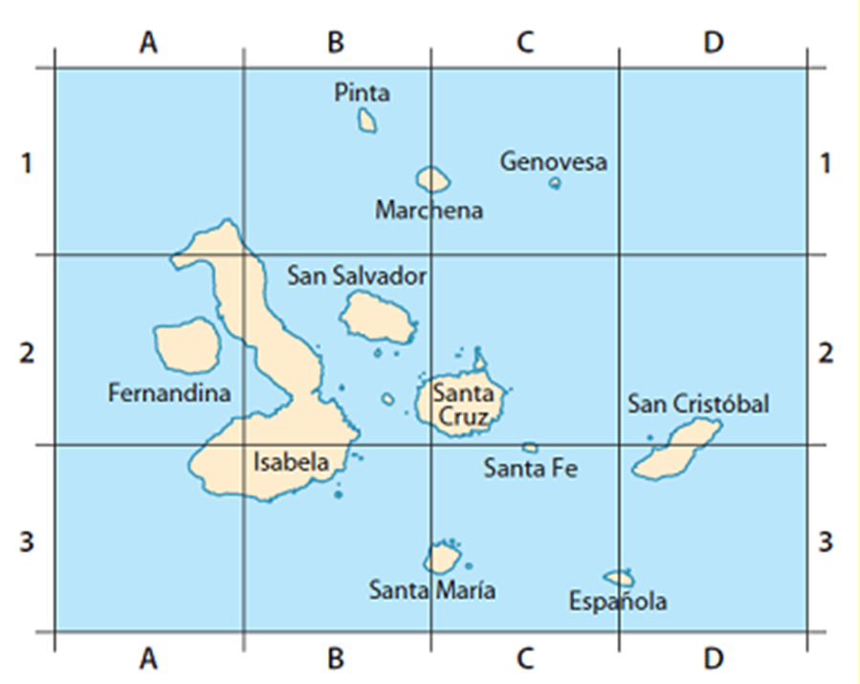
What direction would you travel to go from Santa Maria to Santa Cruz?
A north
B south
C east
D west

Slide 33
What does a political map show?
A natural features on Earth’s surface
B the location of energy sources
C human-created features on Earth’s surface
D the population density of a given area

Slide 34
What is taking place right in front of the cold front?
A cold weather
B hot weather
C sunny, dry weather
D wet, stormy weather

Slide 35
What is an example of human-environment interaction?
A a chart of high temperatures
B a dam used to store water
C the spread of disease
D the erosion caused by waves

Slide 36
When it begins to rain, what process is taking place?
A condensation
B evaporation
C precipitation
D runoff

Slide 37
What do mapmakers use to show Earth’s curved surface on a flat page?
A areas of color
B map projections
C map legend
D labels and symbols

