Slide 1
Regions of Mexico

Slide 2
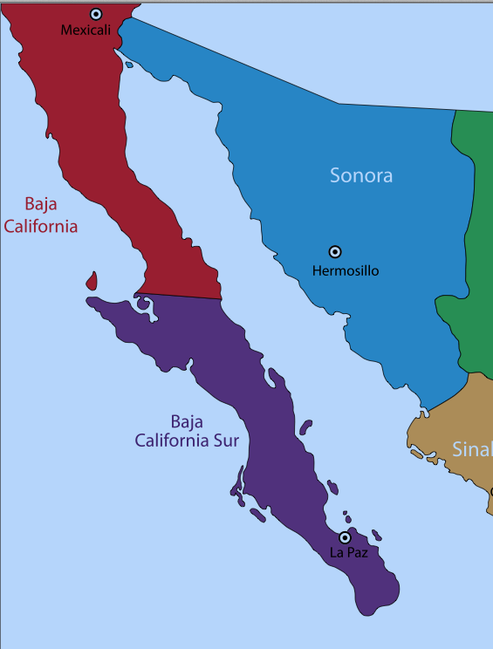
The Pacific Northwest
Located along the United States border by California & Arizona
Includes Baja California
Southern part is tropical
Northern section is part of the Sonora Desert
Animals include coyotes, lizards, & rattlesnakes
Cacti & thorny shrubs live in desert
Contains Mexico’s largest deposits of copper

Slide 3
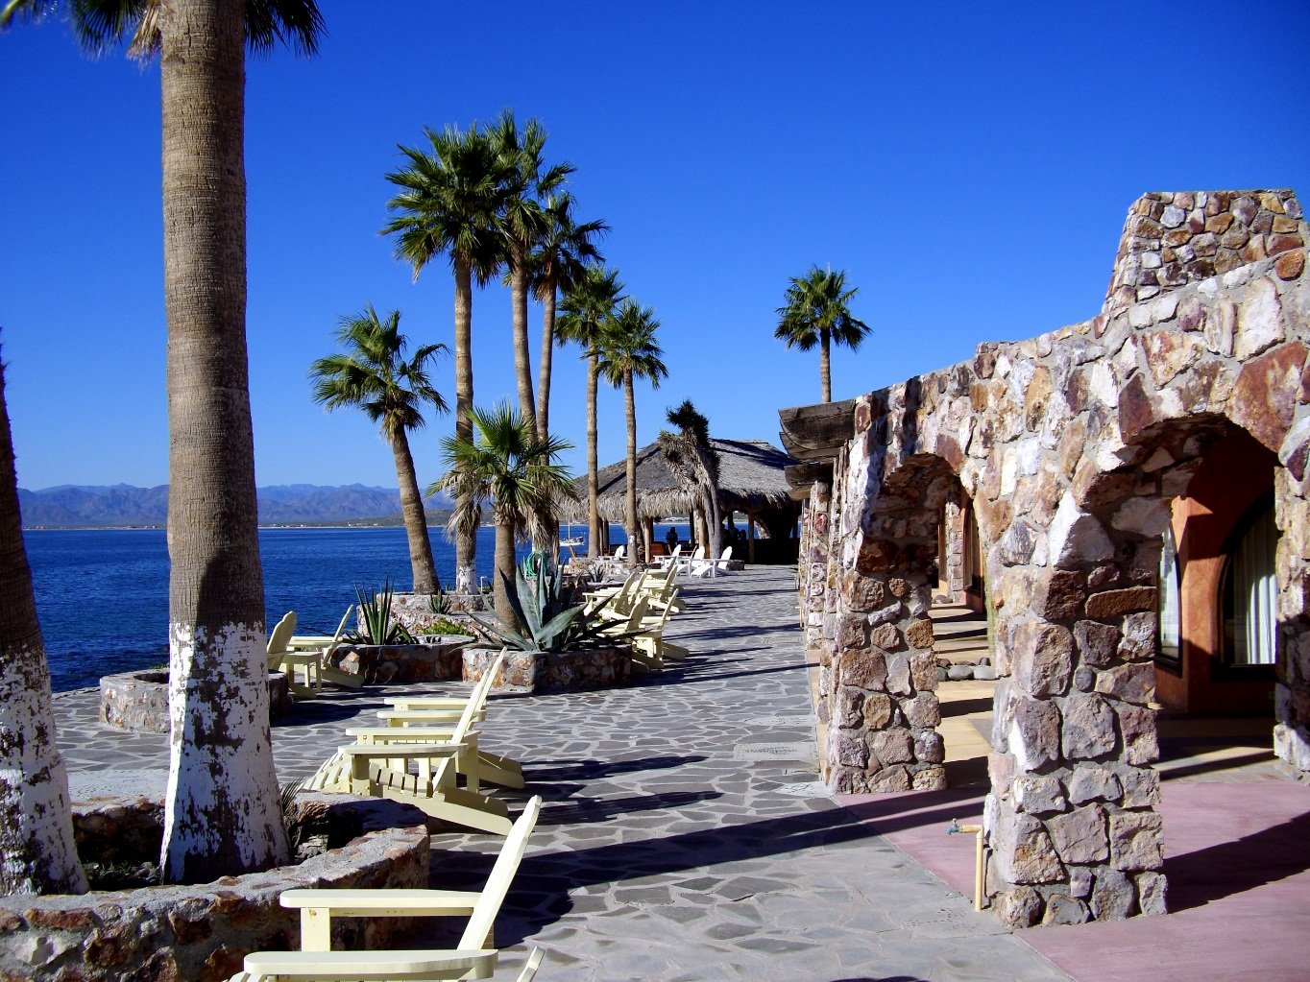
The Pacific Northwest

Slide 4
Plateau of Mexico
Contains most of the population and cities
Center of region is flat & surrounded by two mountain ranges: Sierra Madre Occidental & Sierra Madre Oriental
Deer & mountain lions live in mountains
Northern area holds rich deposits of silver, lead, zinc, & iron
Central & southern areas include rivers & fertile farmland
Features forests where ebony, mahogany, rosewood, & walnut trees are harvested for furniture

Slide 5
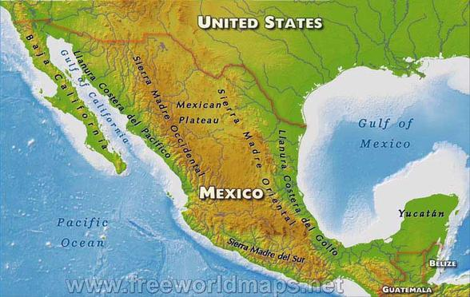
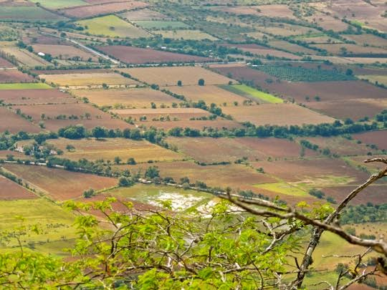
Plateau of Mexico

Slide 6
Gulf Coastal Plain
Covered by tropical rainforests & farmland in the south
Coal, natural gas, & oil are found here
Parts of the Gulf Coast are covered with swamps and lagoons

Slide 7
Gulf Coastal Plain

Slide 8
Southern Uplands
Lie along the Sierra Madre del Sur mountain range
Iron ore & mercury are found in this region
Resort town of Acapulco is on southwestern coast

Slide 9
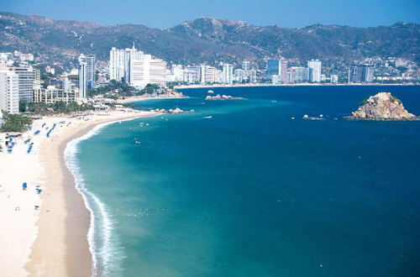
Southern Uplands

Slide 10
Chiapas Highlands
Small region of southern Mexico that borders Guatemala
Consists of block-like mountains & flat farmlands

Slide 11
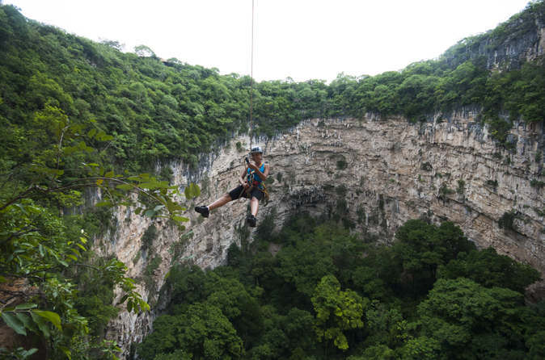
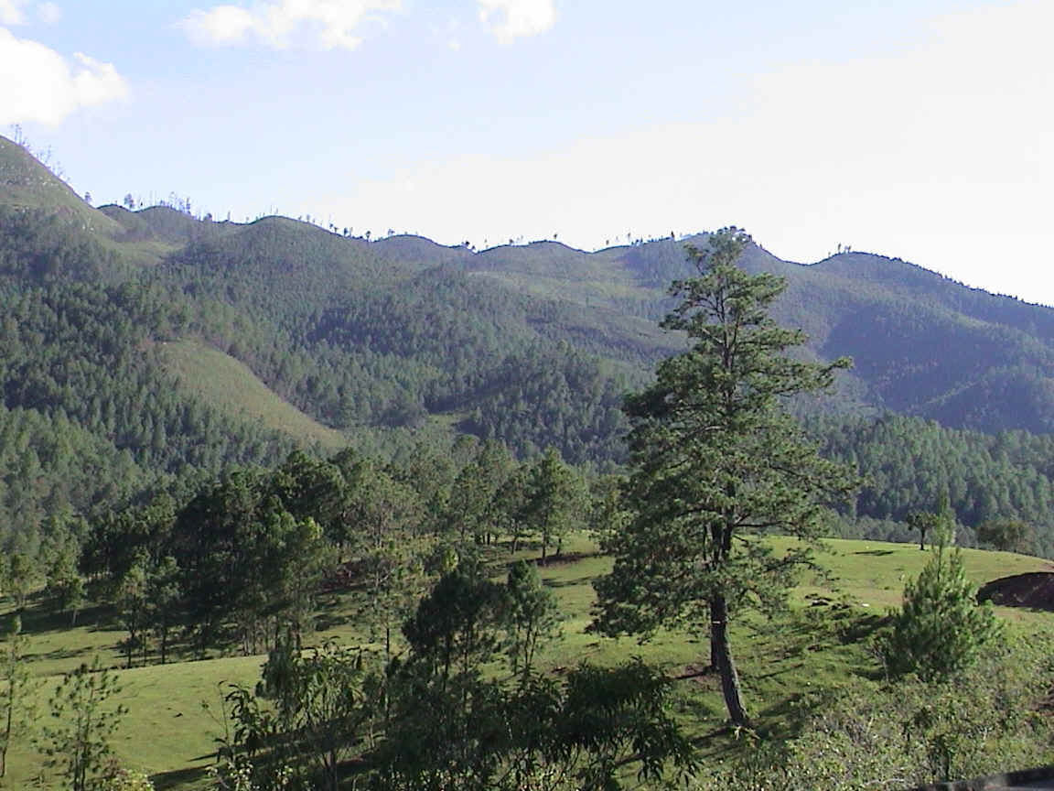
Chiapas Highlands

Slide 12
Yucatan Peninsula
Low plateau of limestone marked with large pits or wells
Northwestern section is dry scrubland
Tropical rainforests cover southern region
Rainforests include alligators, jaguars, opossums, & monkeys

Slide 13
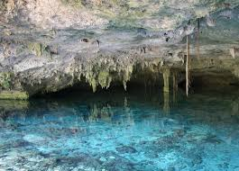
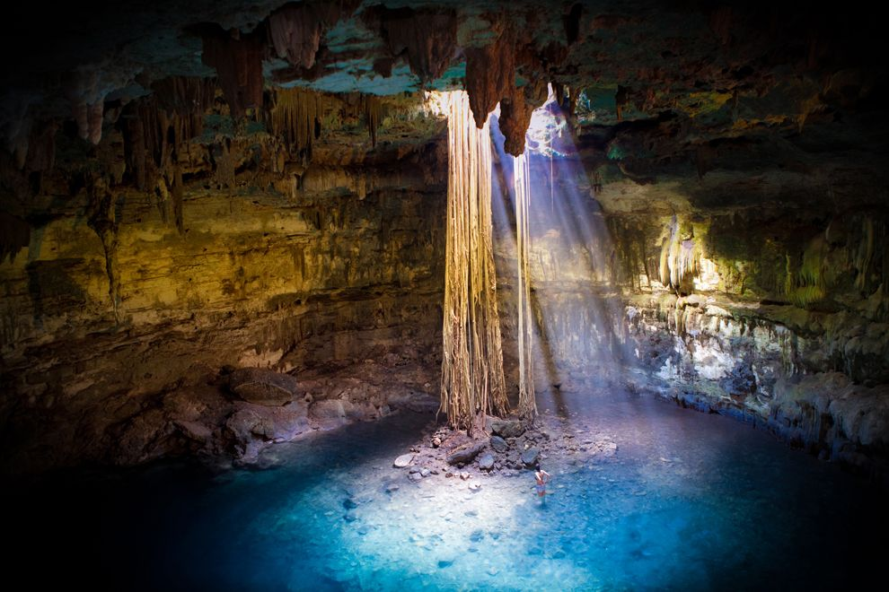
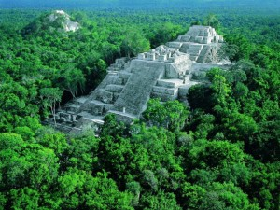
Yucatan Peninsula

