Slide 1
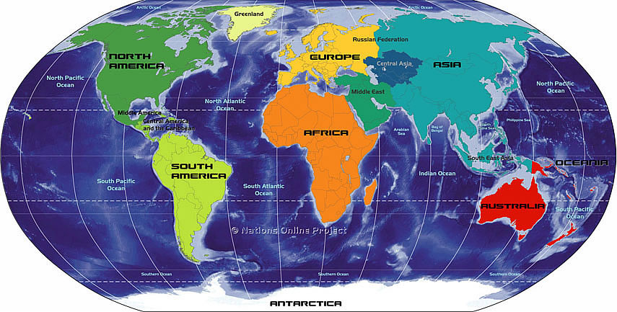
Hemispheres

Slide 2
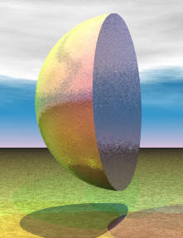
What is hemisphere?
A hemisphere means half of a sphere.
HEMI= half
SPHERE= circle or globe

Slide 3
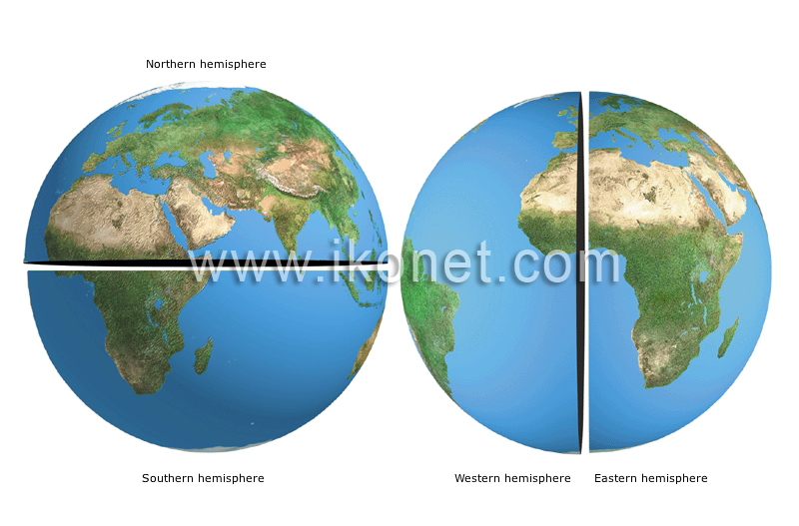
There are 4 hemispheres.
Northern Hemisphere
Southern Hemisphere
Eastern Hemisphere
Western Hemisphere

Slide 4
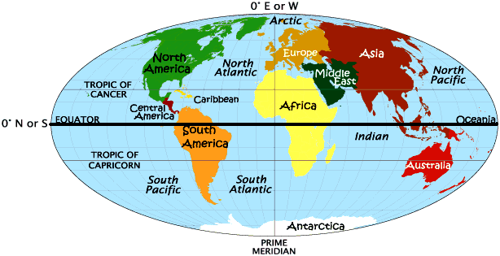
Imaginary lines:
There are 2 main imaginary lines that divide the hemispheres.
1. Equator
2. Prime Meridian

Slide 5
EQUATOR: Divides the earth into northern and southern hemispheres
* Everything above the line is NORTH
* Everything below the line is SOUTH
NORTHERN
HEMISPHERE
NORTH
SOUTHERN
HEMISPHERE
SOUTH

Slide 6
PRIME MERIDIAN: Divides the earth into eastern and western hemispheres
* Everything right of the line is EAST
* Everything left of the line is WEST
WESTERN
HEMISPHERE
EASTERN
HEMISPHERE
WEST
EAST

Slide 7
ON YOUR MAP….
NORTHERN HEMISPHERE
EQUATOR
SOUTHERN HEMISPHERE

Slide 8
ON YOUR MAP….
WESTERN
HEMISPHERE
EASTERN
HEMISPHERE
PRIME MERIDIAN

