Slide 1
Class Feud
Semester 2 Test Review 2017

Slide 2
Round 1
Your team will earn 1 point for each correct answer.

Slide 3
All the land drained by a river and its tributaries
A basin
B delta
C plateau
D strait

Slide 4
The founder of Islam is _____.
A Muhammad
B Confucius
C Abraham
D Jesus

Slide 5
The Arkansas River feeds into the Mississippi River, therefore it is a _____.
A bay
B canal
C strait
D tributary

Slide 6
The major river in South America is the _____.
A Amazon River
B Mississippi River
C Mackenzie River
D St. Lawrence River

Slide 7
The Caribbean is made up of several groups of islands also known as a/an _____.
A archipelago
B atoll
C continent
D oasis

Slide 8
The major religion practiced in Latin America is _____.
A Christianity/Roman Catholic
B Christianity/Protestant
C Buddhism
D Islam

Slide 9
What major body of water forms the northern border of Ontario?
A Arctic Ocean
B Bay of Canada
C Bering Strait
D Hudson Bay

Slide 10
The United States government has some restrictions and regulations for business but the majority of the economic decisions rest with the individual. What kind of economy is this?
A command economy
B communism
C mixed economy
D traditional economy

Slide 11
Florida is an example of a/an _____.
A island
B isthmus
C peninsula
D plateau

Slide 12
Why is Quebec both British and French?
A The French fled Quebec after losing the war
B The British were friendly to the French
C The Quebec Act allowed both cultures
D The Native Americans forced a compromise

Slide 13
Oklahoma, Texas, Arizona, and New Mexico are the Southwest _____.
A location
B place
C region
D movement
E human-environment interaction

Slide 14
Which country is the isthmus that connects North and South America?
A Argentina
B Columbia
C Nicaragua
D Panama

Slide 15
In Cuba the government has complete control of all economic decisions. This is an example of what type of government/economy?
A democracy
B monarchy
C communism
D republic

Slide 16
The majority of religions in the western hemisphere can be classified as _____.
A karma
B monotheistic
C polytheistic
D Quran

Slide 17
What famous manmade waterway connects the Pacific Ocean and Atlantic Ocean?
A Mississippi River
B St. Lawrence Seaway
C Panama Canal
D Suez Canal

Slide 18
Kansas is a very flat area that grows corn is an example of which theme of geography?
A location
B place
C region
D movement
E human-environment interaction

Slide 19
What two countries built and maintain the St. Lawrence Seaway?
A United States and Mexico
B Mexico and Canada
C United States and Canada
D United States and Europe

Slide 20
Many people immigrate from Mexico to the United States in search of jobs is an example of which theme of geography?
A location
B place
C region
D movement
E human-environment interaction

Slide 21
Land at the mouth of a river, made of sand and silt, usually shaped like a triangle.
A basin
B delta
C plateau
D strait

Slide 22
Which indigenous/native peoples were known for their terraced farming techniques?
A Aztec
B Inca
C Inuit
D Maya

Slide 23
A government with elected leaders that represent the people is a _____.
A monarchy
B communist
C democracy
D dictatorship

Slide 24
Why did the British bring African slaves to their colonies?
A to fight against French colonies
B to defeat Native Americans
C to work on big plantations
D to hunt for furs and do craft work

Slide 25
Deforestation is reducing the size of the Amazon Rainforest is an example of which theme of geography?
A location
B place
C region
D movement
E human-environment interaction

Slide 26
The three branches of government in the United States are:
A legislative, executive, and judicial
B congress, president, and house of representatives
C prime minister, parliament, and supreme court
D king, congress, and supreme court

Slide 27
What background do mestizos have?
A African and English
B Spanish
C mixed ancestry
D Native American

Slide 28
In Brazil, from where did most slave labor come?
A Africa
B Asia
C Europe
D North America

Slide 29
What geographic feature stretches nearly the entire width of South America?
A Amazon Basin
B Andes Mountains
C Angel Falls
D Guiana Highlands

Slide 30
Flat land with steep sides, raised above the surrounding land
A basin
B delta
C plateau
D strait

Slide 31
What empire was located along the western coast of South America from 1438 until the 1530s?
A Guarani
B Inca
C Nasca
D Quecha

Slide 32
A narrow channel that joins two larger bodies of water
A basin
B delta
C plateau
D strait

Slide 33
Mexico is found south of the United States and east of the Pacific Ocean is an example of which theme of geography?
A location
B place
C region
D movement
E human-environment interaction

Slide 34
Round 2
Your team will earn 2 points for each correct answer.
Your team will lose 1 point for each wrong answer.

Slide 35
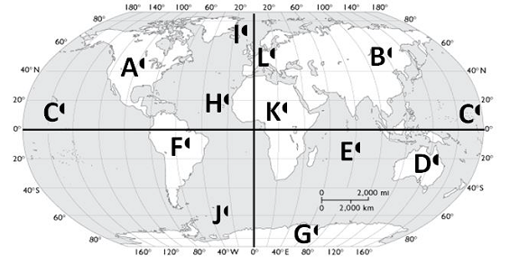
Which continent is letter A located on?
A Canada
B Europe
C North America
D United States

Slide 36
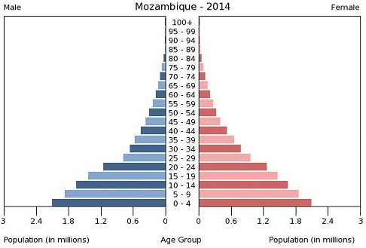
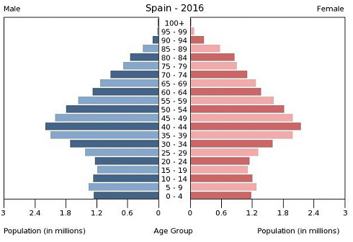
Which country is more developed?
A Mozambique
B Spain

Slide 37
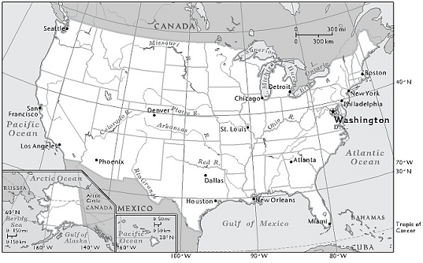
What city is located at 29˚N, 95˚W?
A Dallas
B Denver
C Houston
D New Orleans

Slide 38
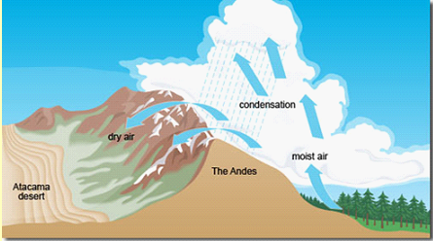
On the western coast of South America warm, moist air is forced over the Andes Mountain Range. Once the air reaches the other side of the range, all moisture has left as precipitation. The Atacama Desert is left with no precipitation. This is an example of a _____.
A plateau
B wetland
C rain shadow
D steppe

Slide 39
Which hemispheres is Australia located in?
A North and East
B North and West
C South and East
D South and West

Slide 40
40˚N, 70˚W is located in what body of water?
A Arctic Ocean
B Atlantic Ocean
C Gulf of Mexico
D Pacific Ocean

Slide 41
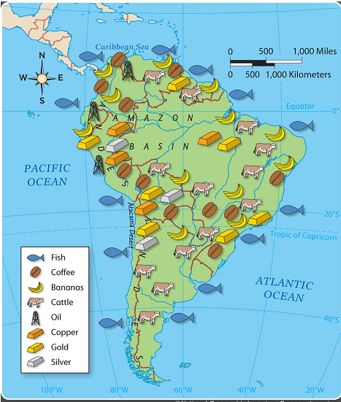
Along which physical feature does most of the mining occur?
A Amazon Rainforest
B Pampas Plains
C Andes Mountains
D Amazon River

Slide 42
Which ocean is letter E located in?
A Atlantic Ocean
B Indian Ocean
C Pacific Ocean
D Southern Ocean

Slide 43
What age group has the largest number of people in Spain?
A 5-9
B 0-4
C 40-44
D 35-39

Slide 44
What is the primary resource in southern Argentina?
A cattle
B oil
C coffee
D silver

Slide 45
What is the only ocean that is located in all four hemispheres?
A Pacific Ocean
B Atlantic Ocean
C Arctic Ocean
D Southern Ocean

Slide 46
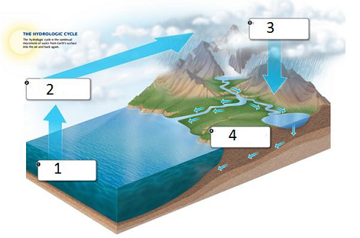
Name the process in 1.
A evaporation
B run-off
C condensation
D precipitation

Slide 47
What are the coordinates of Washington, D.C.?
A 26˚N, 53˚W
B 38˚N, 77˚W
C 40˚N, 80˚W
D 45˚N, 92˚W

Slide 48
Which country’s population is rapidly increasing?
A Mozambique
B Spain

Slide 49
Name the process in 2.
A evaporation
B run-off
C condensation
D precipitation

Slide 50
What ocean is letter H located in ?
A Pacific Ocean
B Atlantic Ocean
C Arctic Ocean
D Southern Ocean

Slide 51
What is the primary resource in Brazil?
A cattle
B oil
C silver
D copper

Slide 52
What age group has the largest number of people in Mozambique?
A 5-9
B 0-4
C 40-44
D 35-39

Slide 53
Name the process in 3.
A evaporation
B run-off
C condensation
D precipitation

